Slide 1
Callback, Timers,
Async JS, HTTP

Slide 2
Callback

Slide 3
Callback
A callback function is a function passed into another function as an argument, which is then invoked inside the outer function to complete some kind of routine or action.

Slide 4
Callback example
function greeting(name) {
alert('Hello ' + name);
}
function processUserInput(callback) {
var name = prompt('Please enter your name.');
callback(name);
}
processUserInput(greeting);

Slide 5
Timers. setTimeout & setInterval

Slide 6
Timers. setTimeout & setInterval
We may decide to execute a function not right now, but at a certain time later. That’s called “scheduling a call”.
There are two methods for it:
setTimeout allows to run a function once after the interval of time.
setInterval allows to run a function regularly with the interval between the runs.

Slide 7
setTimeout

Slide 8
setTimeout
let timerId = setTimeout(callback, delay[, arg1, arg2...])
callback - A function to be executed after the timer expires.
delay - The delay before run, in milliseconds (1000 ms = 1 second). arg1, arg2… - Arguments for the function

Slide 9
setTimeout
function sayHi() { alert('Hello'); } setTimeout(sayHi, 1000);

Slide 10
setTimeout
function sayHi(phrase, who) { alert( phrase + ', ' + who ); } setTimeout(sayHi, 1000, "Hello", "John"); // Hello, John

Slide 11
Canceling with clearTimeout
A call to setTimeout returns a “timer identifier” timerId that we can use to cancel the execution.
let timerId = setTimeout(...); clearTimeout(timerId);

Slide 12
Canceling with clearTimeout
let timerId = setTimeout(() => alert("never happens"), 1000); alert(timerId); // timer identifier clearTimeout(timerId); alert(timerId);
// same identifier (doesn't become null after canceling)

Slide 13
setInterval

Slide 14
setInterval
let timerId = setInterval(callback, delay[, arg1, arg2...])
callback - A function to be executed every delay milliseconds.
delay - The time, in milliseconds (thousandths of a second), the timer should delay in between executions of the specified function or code. arg1, arg2… - Arguments for the function

Slide 15
Canceling with clearInterval
A call to setInterval returns a “timer identifier” timerId that we can use to cancel the execution.
let timerId = setInterval(...); clearInterval(timerId);

Slide 16
setInterval, clearInterval
// repeat with the interval of 2 seconds let timerId = setInterval(() => alert('tick'), 2000); // after 5 seconds stop setTimeout(() => { clearInterval(timerId); alert('stop'); }, 5000);

Slide 17
setTimeout(…,0)

Slide 18
setTimeout(..., 0)
There’s a special use case: setTimeout(func, 0).
This schedules the execution of func as soon as possible. But scheduler will invoke it only after the current code is complete.
So the function is scheduled to run “right after” the current code. In other words, asynchronously.

Slide 19
setTimeout(..., 0)
setTimeout(() => alert("World"), 0); alert("Hello");

Slide 20
Asynchronous JavaScript

Slide 21
Asynchronous JavaScript
In synchronous programs, if you have two lines of code (L1 followed by L2), then L2 cannot begin running until L1 has finished executing.
In asynchronous programs, you can have two lines of code (L1 followed by L2), where L1 schedules some task to be run in the future, but L2 runs before that task completes.

Slide 22
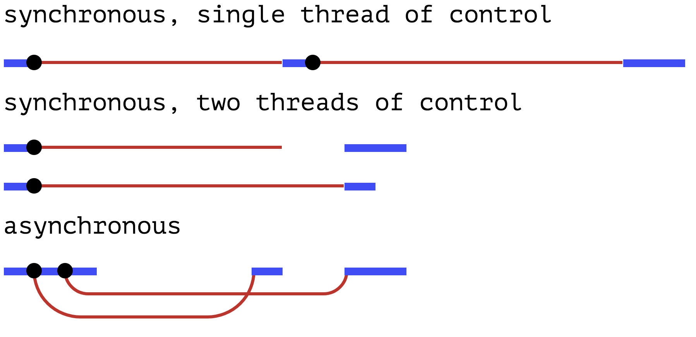
Asynchronous JavaScript

Slide 23
HTTP
Hypertext Transfer Protocol

Slide 24
HTTP - Hypertext Transfer Protocol
HTTP is a protocol which allows the fetching of resources, such as HTML documents. It is the foundation of any data exchange on the Web and a client-server protocol, which means requests are initiated by the recipient, usually the Web browser. A complete document is reconstructed from the different sub-documents fetched, for instance text, layout description, images, videos, scripts, and more.

Slide 25
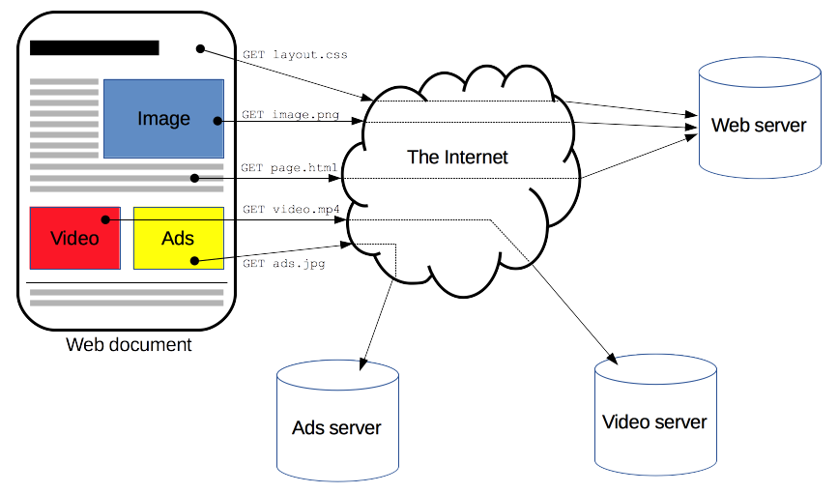
HTTP - Hypertext Transfer Protocol

Slide 26
HTTP - Hypertext Transfer Protocol
Clients and servers communicate by exchanging individual messages (as opposed to a stream of data). The messages sent by the client, usually a Web browser, are called requests and the messages sent by the server as an answer are called responses.

Slide 27
HTTP - Hypertext Transfer Protocol
GET / HTTP/1.1 Host: developer.mozilla.org Accept-Language: fr
HTTP/1.1 200 OK Date: Sat, 09 Oct 2010 14:28:02 GMT Server: Apache Last-Modified: Tue, 01 Dec 2009 20:18:22 GMT ETag: "51142bc1-7449-479b075b2891b" Accept-Ranges: bytes Content-Length: 29769 Content-Type: text/html <!DOCTYPE html... (here comes the 29769 bytes of the requested web page)

Slide 28
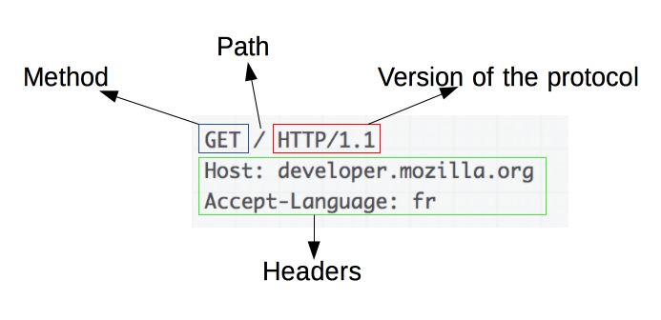
HTTP - Request

Slide 29
HTTP - Request methods
GET
The GET method is used to retrieve information from the given server using a given URI. Requests using GET should only retrieve data and should have no other effect on the data.
POST
A POST request is used to send data to the server, for example, customer information, file upload, etc. using HTML forms.

Slide 30
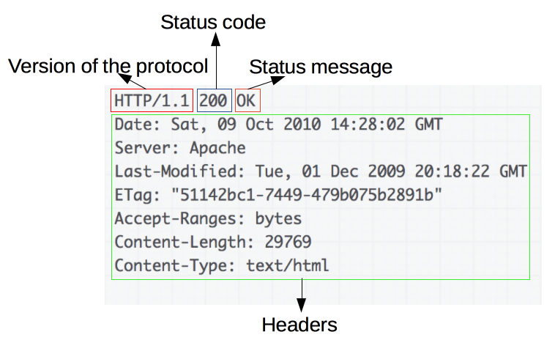
HTTP - Response

Slide 31
HTTP - Response statuses
1xx: Informational It means the request was received and the process is continuing.
2xx: Success It means the action was successfully received, understood, and accepted.
3xx: Redirection It means further action must be taken in order to complete the request.
4xx: Client Error It means the request contains incorrect syntax or cannot be fulfilled.
5xx: Server Error It means the server failed to fulfill an apparently valid request.

Slide 32
HTTP - Response statuses
var xmlHttp = new XMLHttpRequest(); xmlHttp.onreadystatechange = function() { if (xmlHttp.readyState == 4 && xmlHttp.status == 200) console.log(xmlHttp.responseText); } xmlHttp.open("GET", 'https://ghibliapi.herokuapp.com/films/58611129-2dbc-4a81-a72f-77ddfc1b1b49', true); xmlHttp.send(null);

